Slide 1
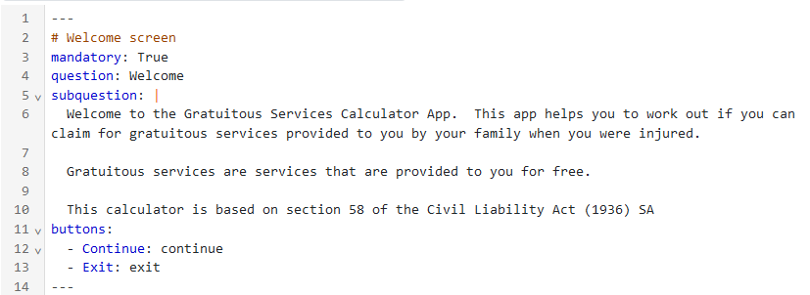
Each block starts and finishes with three dashes.
This is a comment. It isn’t processed as code and describes the block.
Comments are good ☺
There must be one space here
These ‘tags’ are always aligned against the left margin
Text inside a subquestion must be indented by two spaces.
Line numbers show which line you’re on
There must be two spaces here
There must be one space here
There must be one space here

Slide 2
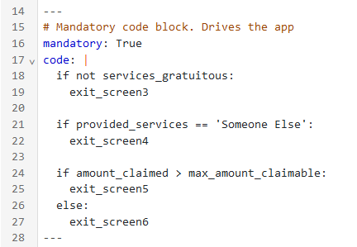
These ‘tags’ are always aligned against the left margin
If statement must finish with a colon
All code in a code block must be indented at least 2 spaces from the margin

